Slide 1
Capstone Project – 1
Project Title : Play store app review analysis By Omaji Pawar

Slide 2
Points for Discussion
Introduction
Data Summary
Steps Involved in EDA
Factors affecting on App Rating
App Size
Factors affecting number of Installs
Most Installed Apps
Type (Free/Paid)
Most Costly apps
Correlation heatmap
Sentiment Analysis
Sentiment Count
Sentiment Polarity vs Sentiment Subjectivity
Conclusion

Slide 3

Introduction
Exploratory Data Analysis (EDA)
In this project we have done exploratory data analysis on google play store data to get some meaningful insights.
The analysis of google play application aided to build most reliable and more interactive applications.
This would be very useful for app developer to build an application focussed on certain discussed category in this analysis.
This analysis will definitely help in building the application with precise and accurate objective.

Slide 4
Data Summary
We had two different datasets
Play Store Apps Data
In given Play store dataset there are total 13 columns and 10841 rows.
It contains all the information of different types of applications like name of app, category of app, ratings from the user, size, installs, type of app(free/paid), price of app, content, genres, last updated date, current version of app available on play store and minimum required android version.
User Reviews Data
In this dataset there are 5 columns and 64295 rows.
It contains information regarding the reviews given by users, like review, sentiment of that review, sentiment polarity and sentiment subjectivity of that particular reviews.

Slide 5
Steps involved in EDA
Data exploration
Null values treatment
Data imputation and manipulation
Outlier treatment
Data visualization
Trends and correlations
Final summary of conclusion

Slide 6
Questions
We will analyse the Play Store data by answering following questions:
1.How distribution of Rating and size look like?
2.What is the average rating per category?
3.Which category has high number of installs? Get 5 most installed apps with corresponding number of installs.
4.Which category have most paid type of apps? Find out the top 5 apps having highest price.
5.What is the percentage of paid and free apps?
6.What are the installs per content rating of apps?
7.Visualize the correlation between all the columns with the help of heatmap.

Slide 7
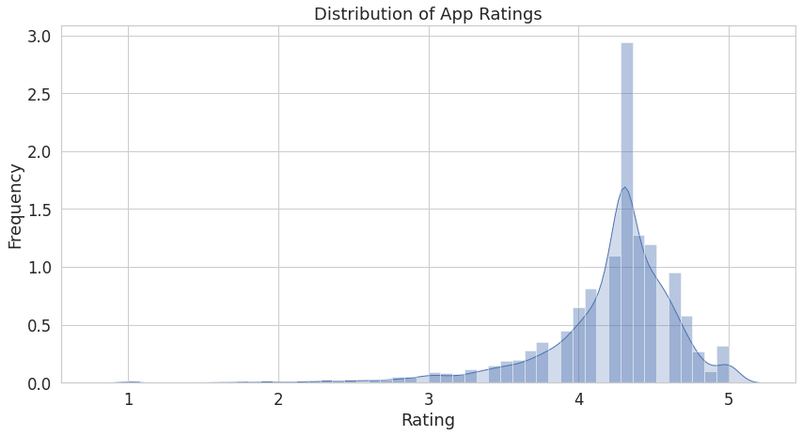
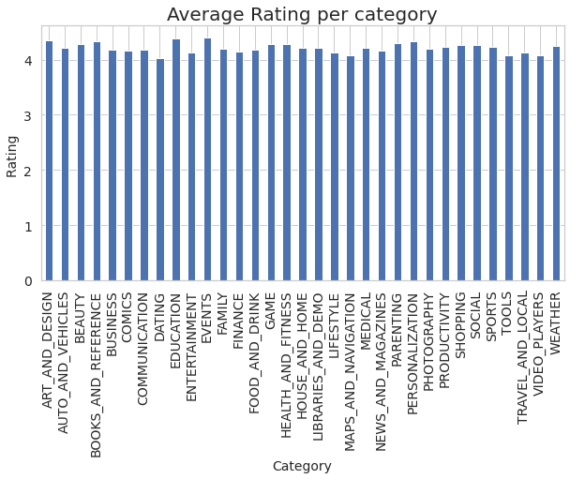
App Ratings
Most of the ratings of apps given by users are in between 3 to 5.
Most number of apps are rated at 4.3
All categories of apps have more than 4 average rating.
Event category has highest average rating with average rating of 4.395313

Slide 8
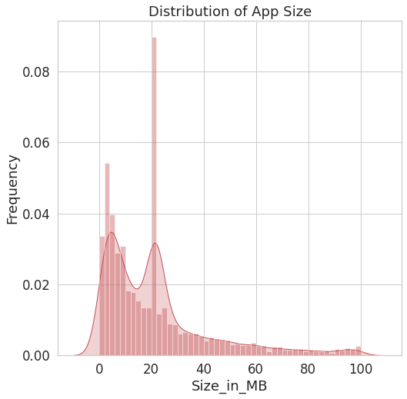
App Size
Maximum number of applications present in the dataset are of small size.

Slide 9
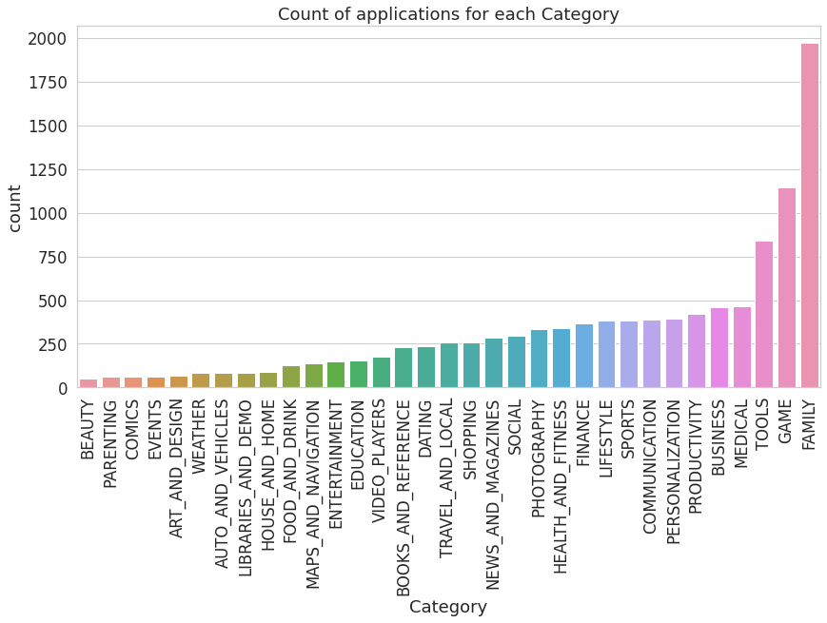
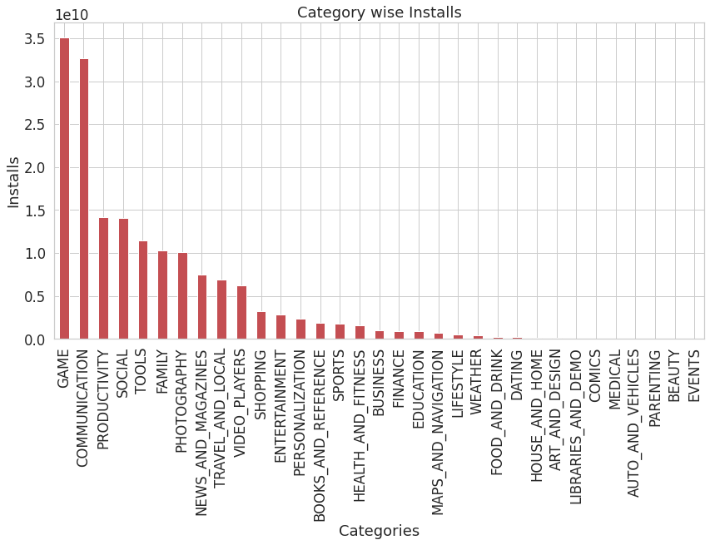
Installs
Category vs Installs
Maximum number of apps present in google play store come under Family, Game and tools but as per the installation and requirement in the market plot, scenario is not the same. Maximum installed apps comes under Game, Communication, Productivity and Social.

Slide 10
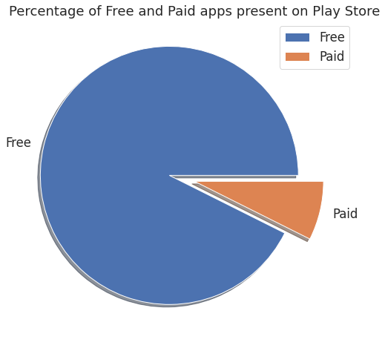
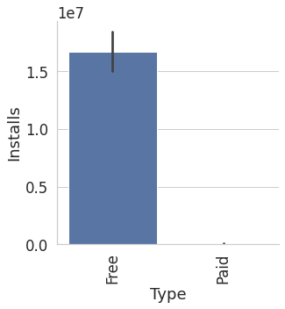
Type (Free/Paid) vs Installs
About 92% apps are free and 8% apps are of paid type.
Free apps are installed more than paid apps.

Slide 11
Content Rating vs Installs
 | Content Rating | Installs
0 | Everyone | 1.141567e+11
1 | Teen | 3.471635e+10
2 | Everyone 10+ | 1.323388e+10
3 | Mature 17+ | 5.524491e+09
4 | Adults only 18+ | 2.000000e+06
5 | Unrated | 5.050000e+04
Content having Everyone only has most installs, while unrated and Adults only 18+ have less installs.
Reviews vs Installs
Number of installs is positively correlated with reviews with correlation 0.64

Slide 12
Most installed Apps
Subway Surfers, Facebook, Messenger and Google Drive are the most installed apps.
 | App | Installs
0 | Subway Surfers | 1.000000e+09
1 | Facebook | 1.000000e+09
2 | Messenger- Text and Video Chat for Free | 1.000000e+09
3 | Google Drive | 1.000000e+09

Slide 13
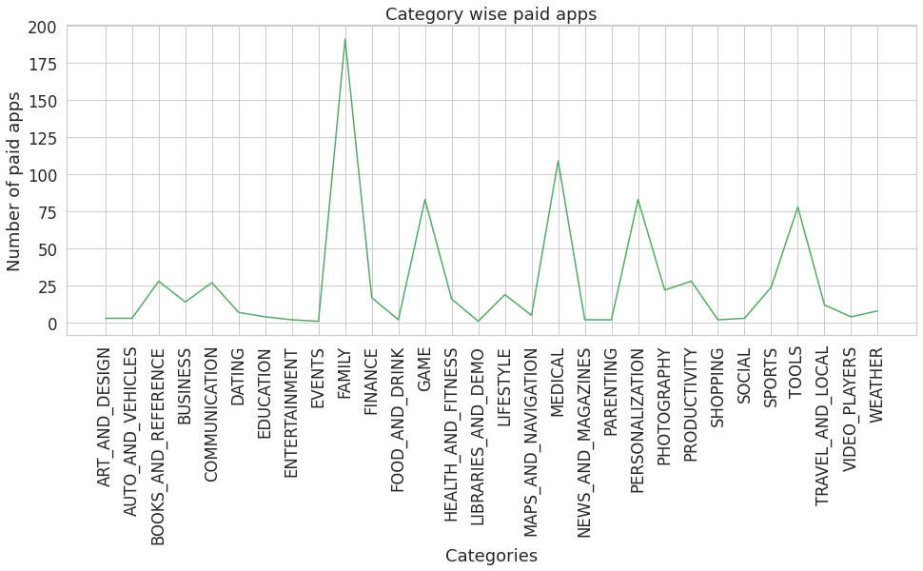
Category wise paid apps
The category ‘Family’ has the highest number of paid apps.

Slide 14
Most costly Apps on Play store
The app “I’m Rich — Trump Edition” from the category ‘Lifestyle’ is the most costly app priced at $400
 | App | Price | Category
0 | I'm Rich - Trump Edition | 400.00 | LIFESTYLE
1 | I am rich(premium) | 399.99 | FINANCE
2 | I AM RICH PRO PLUS | 399.99 | FINANCE
3 | I'm Rich/Eu sou Rico/أنا غني/我很有錢 | 399.99 | LIFESTYLE
4 | I am Rich Plus | 399.99 | FAMILY

Slide 15
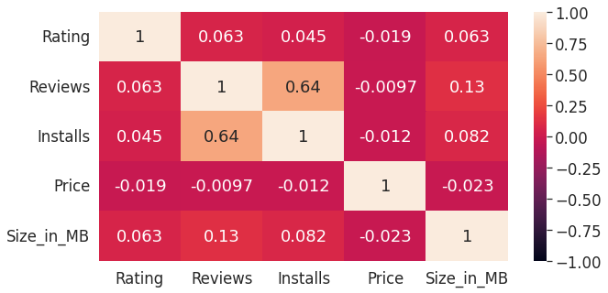
Correlation Heatmap
Correlation heatmap is graphical representation of correlation matrix representing correlation between different variables. The value of correlation can take any value from -1 to 1.
From this correlation heatmap we can see how variables are correlated with each other.
Number of Installs are positively correlated with Reviews with correlation 0.64
Price is slight negatively correlated with Rating and Reviews.

Slide 16
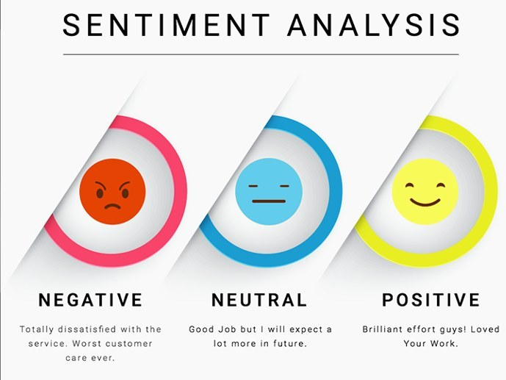
Sentiment Analysis
We had done sentiment analysis on user_review data.
Analyzing user sentiments towards apps through their review comments and ratings can be economically profitable to app developers.
This user data contains name of App, Review given by the user, Sentiment of review, Sentiment Polarity and and Sentiment Subjectivity.

Slide 17
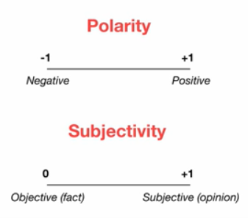
Understanding Features
App - Name of App
Sentiment - A view or opinion that is held or expressed. It can be Positive, Negative or Neutral.
Sentiment Polarity -Sentiment polarity for an element defines the orientation of the expressed sentiment, i.e., it determines if the text expresses the positive, negative or neutral sentiment of the user about the entity in consideration. The polarity score is a float within the range [-1.0, 1.0]
Sentiment Subjectivity - Subjectivity quantifies the amount of personal opinion and factual information contained in the text. The higher subjectivity means that the text contains personal opinion rather than factual information. Subjectivity lies between [0.0,1.0]. 0.0 is very objective and 1.0 is very subjective.

Slide 18
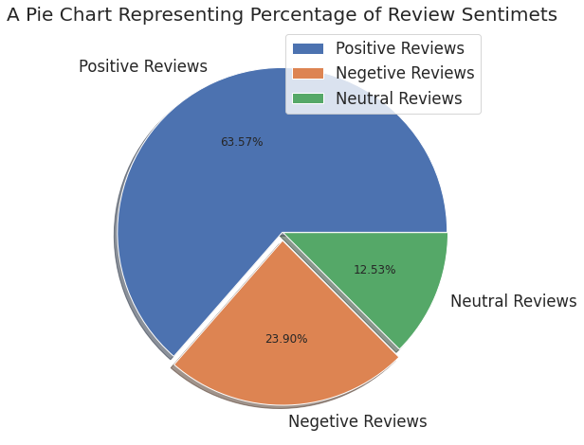
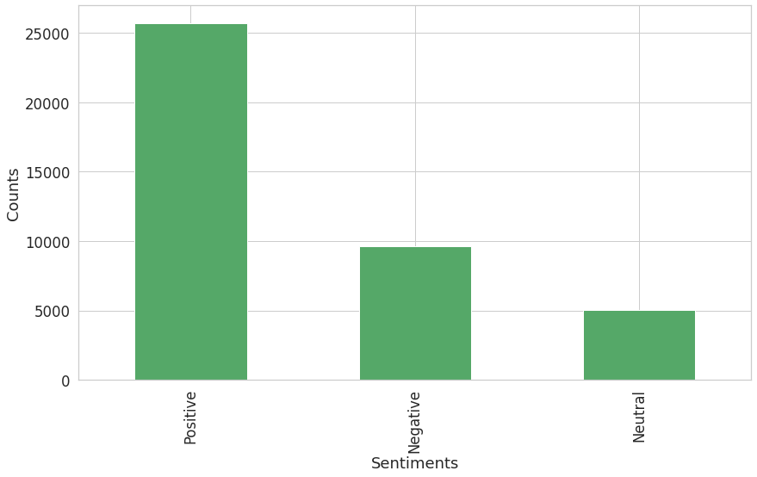
Sentiment
Most of the reviews are of Positive Sentiment, while Negative and Neutral have low number of reviews.
Out of total reviews there are 63.57% reviews are positive, 23.90% reviews are Negative and 12.53% reviews are of Neutral Sentiment.

Slide 19
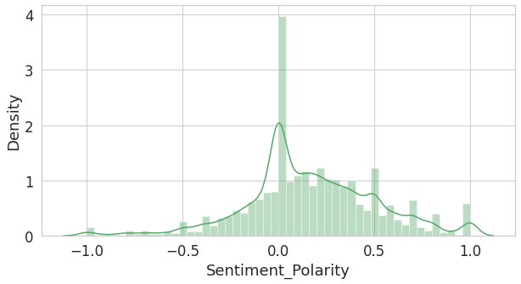
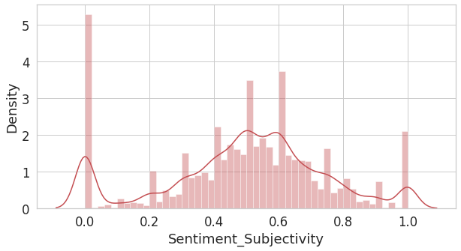
Distribution of Sentiment Polarity and Subjectivity
As we can see in the above distplots most of the reviews fall in [-0.50,0.75] Polarity scale, extremely negative or positive sentiments are significantly low.
Most of the reviews fall in [0.3,0.8] Subjectivity scale.

Slide 20
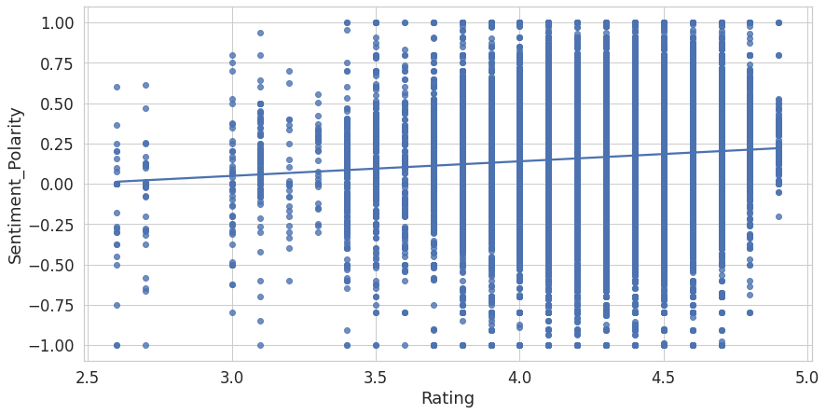
Rating vs Sentiment Polarity
After merging Play Store dataset and user_review dataset on App.
We had plotted a regplot between Rating and Sentiment Polarity.
.
The correlation between sentiment polarity and rating is not as strong as we thought, though we can see the trend there.

Slide 21
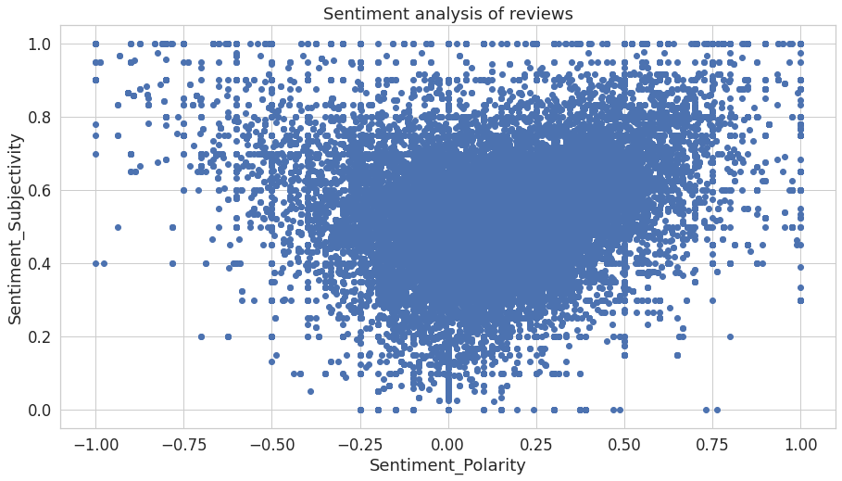
Sentiment Polarity vs Sentiment Subjectivity
Scatter plots' primary uses are to observe and show relationships between two numeric variables. The dots in a scatter plot not only report the values of individual data points, but also patterns when the data are taken as a whole.

Slide 22
Conclusions from scatter plot between Sentiment Polarity and Sentiment Subjectivity
Polarity is concentrated mostly in the center and the subjectivity is spread out across the graph.
This indicates that our collection of reviews shows a wide range of subjectivity and most of the reviews fall in [-0.50,0.75] polarity scale implying that the extremely negative or positive sentiments are significantly low.
Most of the reviews show a mid-range of negative and positive sentiments.
In the graph, reviews with low subjectivity are concentrated at the center of the polarity range [-1, +1]
And the reviews with high subjectivity are scattered across the polarity range [-1, +1].
This is understandable because a fact (low subjectivity) is more likely to be neutral (with polarity 0) and an opinion (high subjectivity) is more likely to have a diverse range of negative to positive sentiments.
From the scatter plot it can be concluded that sentiment subjectivity is not always proportional to sentiment polarity but in maximum number of case, shows a proportional behavior, when variance is too high or low.

Slide 23
Conclusion
Most of the apps have rating in between 4 and 5.
Most numbers of apps are rated at 4.3
All categories of apps have more than 4 average rating.
Maximum number of applications present in the dataset are of small size.
Majority of the apps come into these three categories, Family, Game, and Tools.
Maximum number of apps present in google play store come under Family, Game and tools but as per the installation and requirement in the market plot, scenario is not the same. Maximum installed apps comes under Game, Communication, Productivity and Social.
Subway Surfers, Facebook, Messenger and Google Drive are the most installed apps.
About 92% apps are free and 8% apps are of paid type.
The category ‘Family’ has the highest number of paid apps.
Free apps are installed more than paid apps.
The app “I’m Rich — Trump Edition” from the category ‘Lifestyle’ is the most costly app priced at $400
Content having Everyone only has most installs, while unrated and Adults only 18+ have less installs.
Number of installs is positively correlated with reviews with correlation 0.64

Slide 24
Conclusions (Continued..)
Most of the reviews are of Positive Sentiment, while Negative and Neutral have low number of reviews.
Collection of reviews shows a wide range of subjectivity and most of the reviews fall in [-0.50,0.75] polarity scale implying that the extremely negative or positive sentiments are significantly low.
Most of the reviews show a mid-range of negative and positive sentiments.
Sentiment subjectivity is not always proportional to sentiment polarity but in maximum number of case, shows a proportional behavior, when variance is too high or low.
Sentiment Polarity is not highly correlated with Sentiment Subjectivity.
The analysis of Google Play Store application aided to build most reliable and more interactive applications. This would be very useful for app developer to build an application focussed on certain discussed category in this analysis. This analysis will definitely help in building the application with precise and accurate objectives.

Slide 25
Thank You

